Slide 1
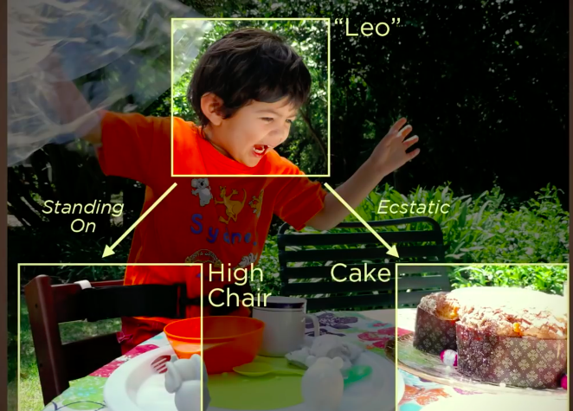
Introduction to CNN

Slide 2
Topics to be covered…
Convolutional neural network
Convolution layer, ReLU Activation Function
Padding, Stride
Pooling layer
Flattening, Subsampling
Loss layer, Dense layer
1x1 convolution, Input channels
Implementation of CNN with TensorFlow, Keras

Slide 3
Introduction to Convolution Neural Network
Convolutional Neural Networks are very similar to ordinary Neural Networks.
They are made up of neurons that have learnable weights and biases.
Convolutional neural networks, also called ConvNets, were first introduced in the 1980s by Yann LeCun, a postdoctoral computer science researcher.
The early version of CNNs, called LeNet (after LeCun), could recognize handwritten digits. CNNs found a niche market in banking and postal services and banking, where they read zip codes on envelopes and digits on checks.
But despite their ingenuity, ConvNets remained on the sidelines of computer vision and artificial intelligence because they faced a serious problem: They could not scale.
In 2012, AlexNet showed that perhaps the time had come to revisit deep learning, the branch of AI that uses multi-layered neural networks.

Slide 4
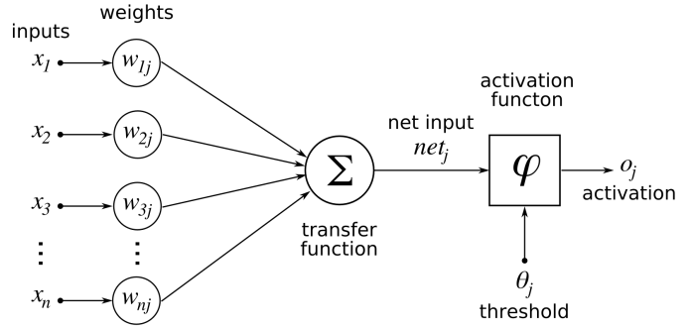
Introduction to Convolution Neural Network

Slide 5
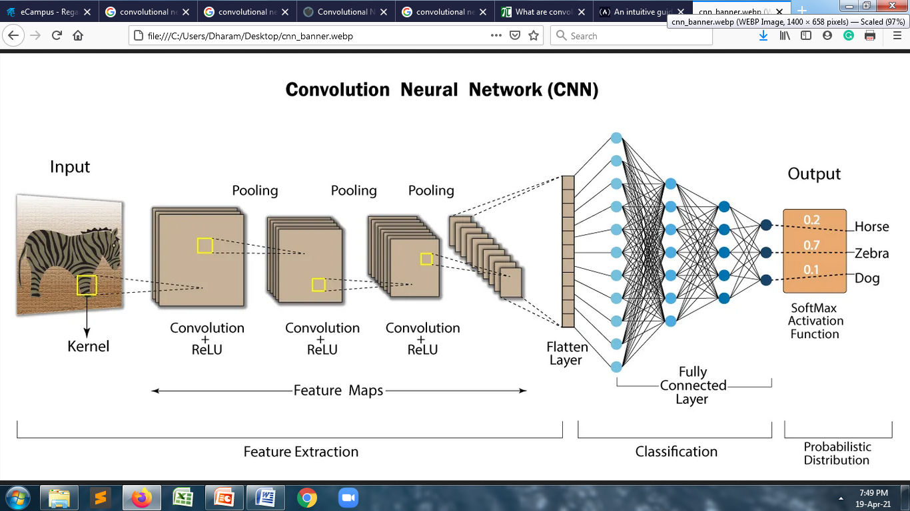
Introduction to Convolution Neural Network

Slide 6
Introduction to Convolution Neural Network
Convolution Neural Network has input layer, output layer, many hidden layers and millions of parameters that have the ability to learn complex objects and patterns.
Convolutional Neural Networks are a bit different. First of all, the layers are organized in 3 dimensions: width, height and depth.
Further, the neurons in one layer do not connect to all the neurons in the next layer but only to a small region of it. Lastly, the final output will be reduced to a single vector of probability scores, organized along the depth dimension.
It sub-samples the given input by convolution and pooling processes and is subjected to activation function, where all of these are the hidden layers which are partially connected and at last end is the fully connected layer that results in the output layer.
The output retains the original shape similar to input image dimensions.

Slide 7
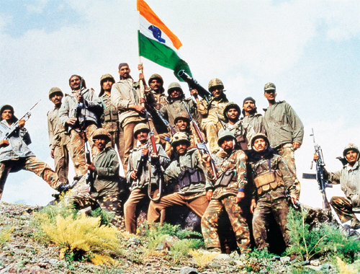
Limitations of CNN
Understanding the meaning of the contents of images, they perform poorly.

Slide 8
Limitations of CNN
But despite the vast repositories of images and videos they’re trained on, they still struggle to detect and block inappropriate content.
In one case, Facebook’s content-moderation AI banned the photo of a 30,000-year-old statue as nudity.
Several studies have shown that CNNs trained on ImageNet and other popular datasets fail to detect objects when they see them under different lighting conditions and from new angles.
A recent study by researchers at the MIT-IBM Watson AI Lab highlights these shortcomings. It also introduces ObjectNet, a dataset that better represents the different nuances of how objects are seen in real life.
CNNs don’t develop the mental models that humans have about different objects and their ability to imagine those objects in previously unseen contexts.

Slide 9
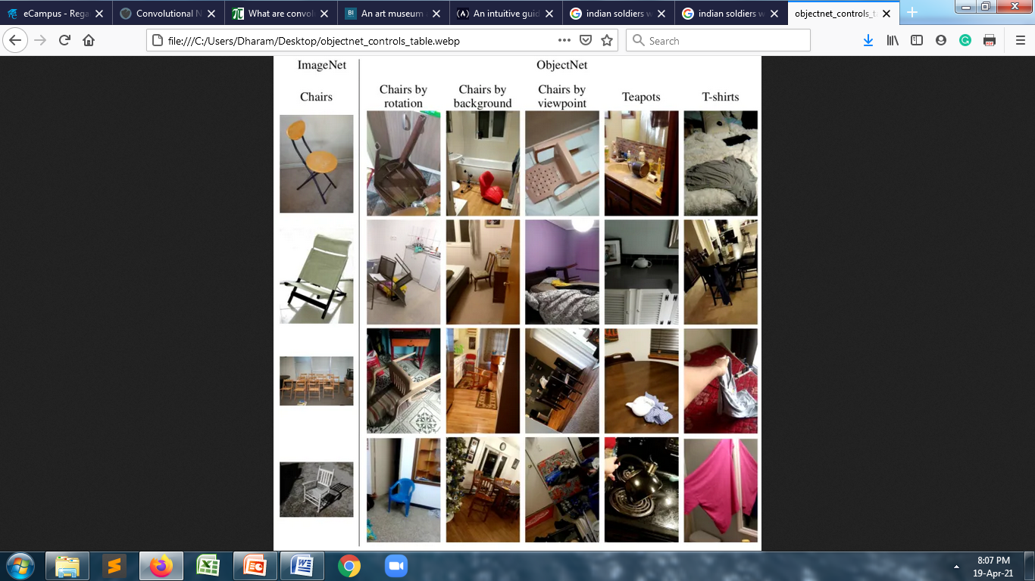
Limitations of CNN

Slide 10
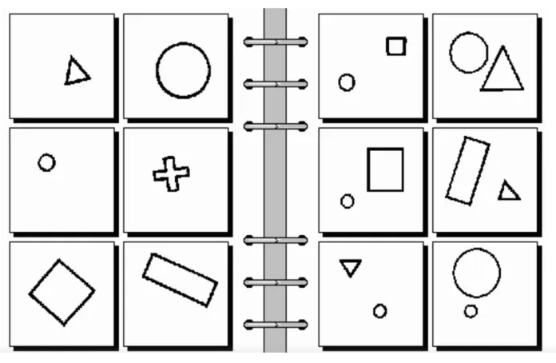
Limitations of CNN
Another problem with convolutional neural networks is their inability to understand the relations between different objects. Consider the following image, which is known as a “Bongard problem”.

Slide 11
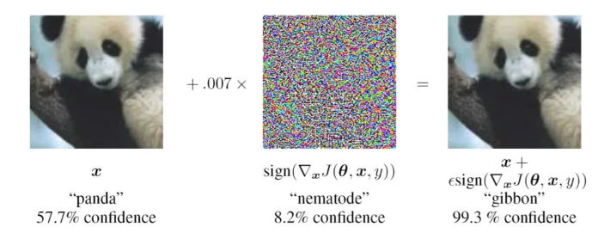
Limitations of CNN
Adversarial attacks have become a major source of concern as deep learning and especially CNNs have become an integral component of many critical applications such as self-driving cars.

Slide 12
Convolution Layer
Convolution is one of the main building blocks of a CNN. The term convolution refers to the mathematical combination of two functions to produce a third function. It merges two sets of information.
In the case of a CNN, the convolution is performed on the input data with the use of a filter or kernel (these terms are used interchangeably) to then produce a feature map.
We execute a convolution by sliding the filter over the input. At every location, a matrix multiplication is performed and sums the result onto the feature map.

Slide 13
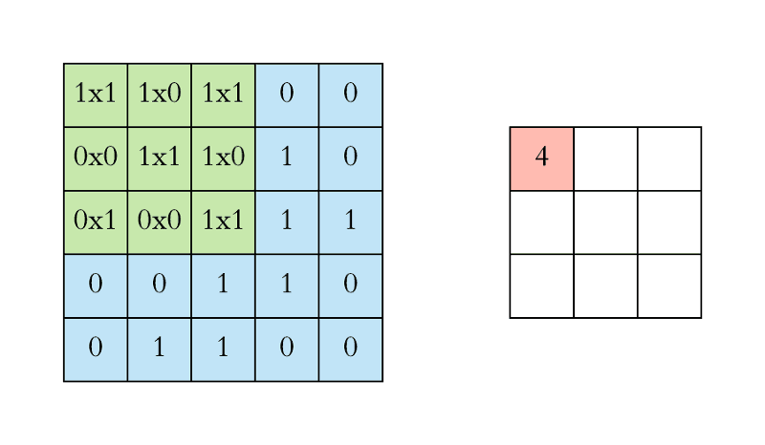
Convolution Layer
In the animation below, you can see the convolution operation. You can see the filter (the green square) is sliding over our input (the blue square) and the sum of the convolution goes into the feature map (the red square).
The area of our filter is also called the receptive field, named after the neuron cells! The size of this filter is 3x3.

Slide 14
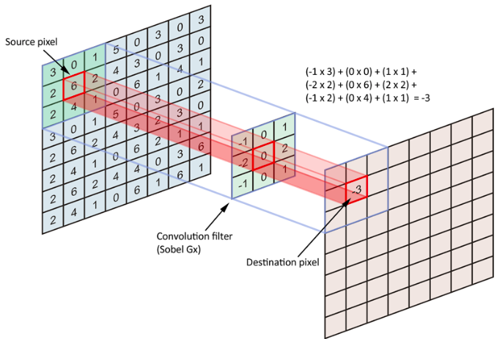
Convolution Layer
In reality convolutions are performed in 3D. Each image is namely represented as a 3D matrix with a dimension for width, height, and depth. Depth is a dimension because of the colors channels used in an image (RGB).

Slide 15
Convolution Layer
We perform numerous convolutions on our input, where each operation uses a different filter. This results in different feature maps.
In the end, we take all of these feature maps and put them together as the final output of the convolution layer.
Just like any other Neural Network, we use an activation function to make our output non-linear. In the case of a Convolutional Neural Network, the output of the convolution will be passed through the activation function. This could be the ReLU activation function, y = max(0, x).
For example:
In a given matrix(M), M= [ [ -3, 19, 5 ], [ 7, -6, 12 ], [ 4, -8, 17 ] ]
ReLU converts it as: [ [ 0, 19, 5 ], [ 7, 0, 12 ], [ 4, 0, 17 ] ]
ReLU is used more often as it works fast, allows the network to converge very quickly and is computationally efficient.

Slide 16

Stride
Stride is the size of the step the convolution filter moves each time. A stride size is usually 1, meaning the filter slides pixel by pixel.
By increasing the stride size, your filter is sliding over the input with a larger interval and thus has less overlap between the cells.
More the value of stride, smaller will be the resulting output and vice versa.

Slide 17
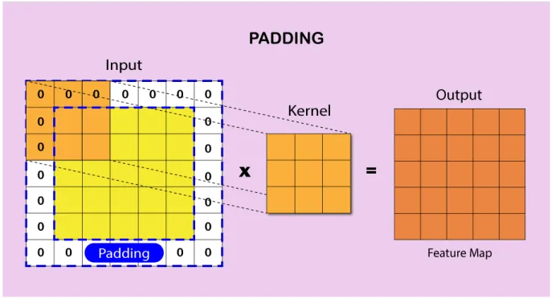
Padding
Because the size of the feature map is always smaller than the input, we have to do something to prevent our feature map from shrinking. This is where we use padding.
A layer of zero-value pixels is added to surround the input with zeros, so that our feature map will not shrink. Padding also improves performance and makes sure that the kernel and stride size will fit in the input.

Slide 18
Pooling
After a convolution layer, it is common to add a pooling layer in between CNN layers. The function of pooling is to continuously reduce the dimensionality to reduce the number of parameters and computation in the network. This shortens the training time and controls overfitting.
There can be many number of convolution, ReLU and pooling layers. Initial layers of convolution learns generic information and last layers learn more specific/complex features.
Pooling can be done in following ways :
  Max-pooling : It selects maximum element from the feature map. The resulting max-pooled layer holds important features of feature map. It is the most common approach as it gives better results.
  Average pooling : It involves average calculation for each patch of the feature map.

Slide 19
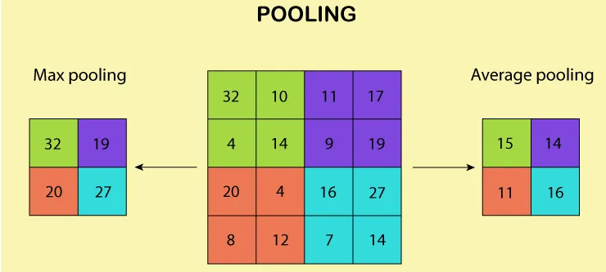
Pooling

Slide 20
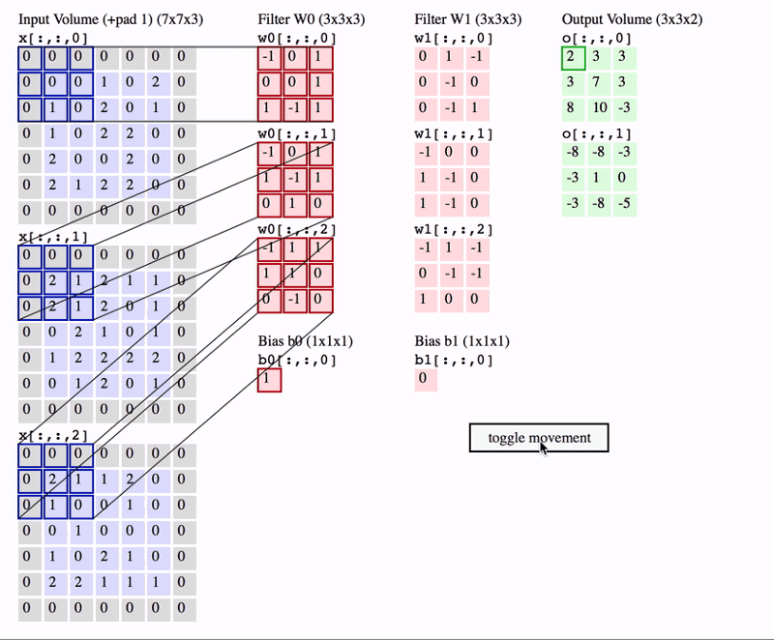
Example

Slide 21
Classification
After the convolution and pooling layers, our classification part consists of a few fully connected layers. However, these fully connected layers can only accept 1 Dimensional data. To convert our 3D data to 1D, we use the function flatten in Python. This essentially arranges our 3D volume into a 1D vector.
The last layers of a Convolutional NN are fully connected layers. Neurons in a fully connected layer have full connections to all the activations in the previous layer. This part is in principle the same as a regular Neural Network.
Since all the parameters are occupied into fully-connected layer, it causes overfitting. Dropout is one of the techniques that reduces overfitting.
Dropout is an approach used for regularization in neural networks. It is a technique where randomly chosen nodes are ignored in network during training phase at each stage.

Slide 22
Classification
Soft-max is an activation layer normally applied to the last layer of network that acts as a classifier. Classification of given input into distinct classes takes place at this layer. The soft max function is used to map the non-normalized output of a network to a probability distribution.
The output from last layer of fully connected layer is directed to soft max layer, which converts it into probabilities.
Here soft-max assigns decimal probabilities to each class in a multi-class problem, these probabilities sum equals 1.0.
This allows the output to be interpreted directly as a probability.

Slide 23
Hyperparameters in CNN
Thus when using a CNN, the four important hyperparameters we have to decide on are:
  Kernel size
  Filter count (that is, how many filters do we want to use)
  Stride (how big are the steps of the filter)
  Padding

Slide 24
Loss Layer
In the context of an optimization algorithm, the function used to evaluate a candidate solution (i.e., a set of weights) is referred to as the objective function.
Typically, with neural networks, we seek to minimize the error. As such, the objective function is often referred to as a cost function or a loss function and the value calculated by the loss function is referred to as simply “loss.”
The cost or loss function has an important job in that it must faithfully distill all aspects of the model down into a single number in such a way that improvements in that number are a sign of a better model.
The cost function reduces all the various good and bad aspects of a possibly complex system down to a single number, a scalar value, which allows candidate solutions to be ranked and compared.
It is important, therefore, that the function faithfully represent our design goals. If we choose a poor error function and obtain unsatisfactory results, the fault is ours for badly specifying the goal of the search.

Slide 25
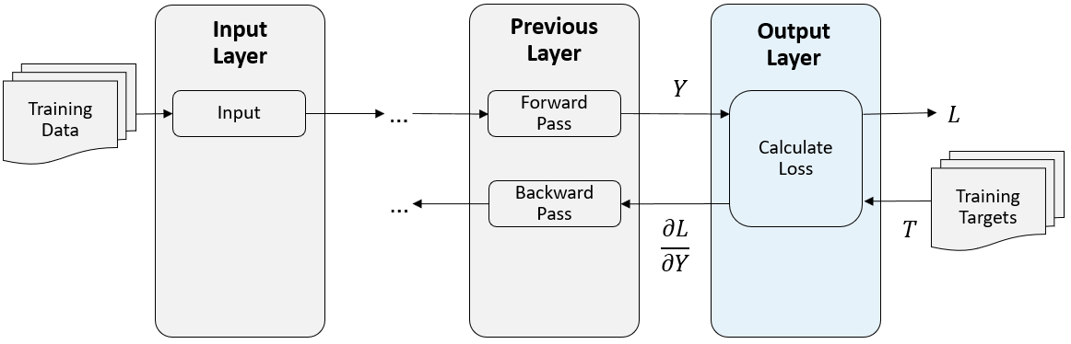
Loss Layer

Slide 26
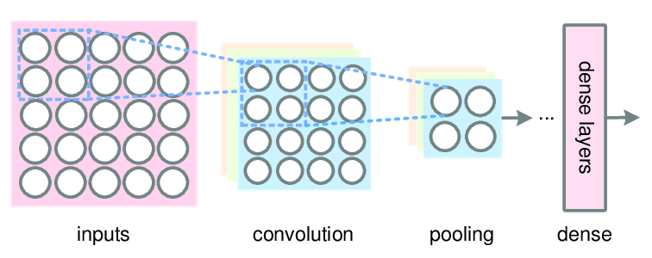
Dense Layer
Dense layer is the regular deeply connected neural network layer. It is most common and frequently used layer. Dense layer does the below operation on the input and return the output.
output = activation(dot(input, kernel) + bias)
where,
  Input represents the input data
  Kernel represents the weight data
  Dot represents dot product of all input and its corresponding weights
  Bias represents a biased value used in machine learning to optimize the model
  Activation represents the activation function.

Slide 27
1x1 Convolution
Convolutions layers are lighter than fully connected ones. But they still connect every input channels with every output channels for every position in the kernel windows.
A 1x1 convolution kernel acts as an embedding solution. It reduces the size of the input vector, the number of channels. It makes it more meaningful. The 1x1 convolutional layer is also called a Point wise Convolution.
In 1X1 Convolution simply means the filter is of size 1X1 (Yes — that means a single number as opposed to matrix like, say 3X3 filter). This 1X1 filter will convolve over the ENTIRE input image pixel by pixel.
Staying with our example input of 64X64X3, if we choose a 1X1 filter (which would be 1X1X3), then the output will have the same Height and Weight as input but only one channel — 64X64X1.

Slide 28
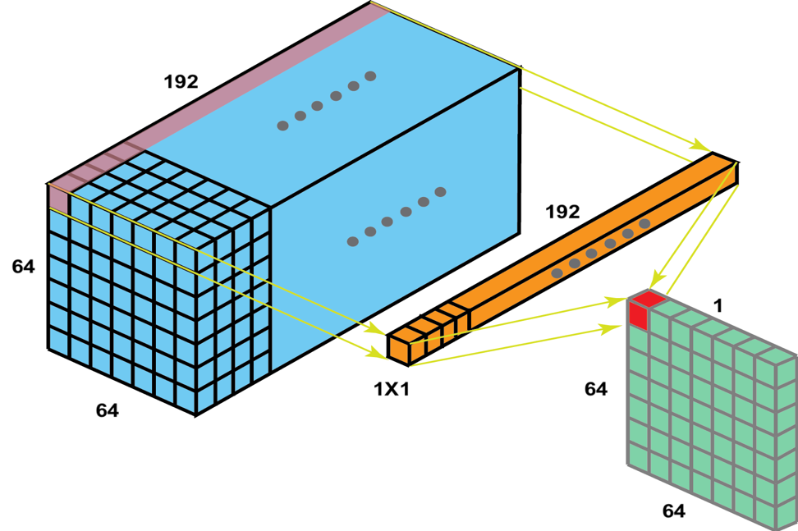
1x1 Convolution
1X1 Convolution is effectively used for:
  Dimensionality Reduction/Augmentation
  Reduce computational load by reducing parameter map
  Add additional non-linearity to the network
  Create deeper network through “Bottle-Neck” layer
  Create smaller CNN network which retains higher degree of accuracy

Slide 29
Implementation of CNN with TensorFlow
Step 1: Import TensorFlow
  import tensorflow as tf
  from tensorflow.keras import datasets, layers, models
  import matplotlib.pyplot as plt
Step 2: Download and prepare the CIFAR10 dataset
  The CIFAR10 dataset contains 60,000 color images in 10 classes, with 6,000 images in each class. The dataset is divided into 50,000 training images and 10,000 testing images. The classes are mutually exclusive and there is no overlap between them.
  (train_images, train_labels), (test_images, test_labels) = datasets.cifar10.load_data()
  # Normalize pixel values to be between 0 and 1
  train_images, test_images = train_images / 255.0, test_images / 255.0

Slide 30
Implementation of CNN with TensorFlow
Step 3: Verify the data
  class_names = ['airplane', 'automobile', 'bird', 'cat', 'deer',
  'dog', 'frog', 'horse', 'ship', 'truck']
  plt.figure(figsize=(10,10))
  for i in range(25):
  plt.subplot(5,5,i+1)
  plt.xticks([])
  plt.yticks([])
  plt.grid(False)
  plt.imshow(train_images[i], cmap=plt.cm.binary)
  # The CIFAR labels happen to be arrays,
  # which is why you need the extra index
  plt.xlabel(class_names[train_labels[i][0]])
  plt.show()
Step 4: Create the convolutional base
  model = models.Sequential()
  model.add(layers.Conv2D(32, (3, 3), activation='relu', input_shape=(32, 32, 3)))
  model.add(layers.MaxPooling2D((2, 2)))
  model.add(layers.Conv2D(64, (3, 3), activation='relu'))
  model.add(layers.MaxPooling2D((2, 2)))
  model.add(layers.Conv2D(64, (3, 3), activation='relu'))

Slide 31
Implementation of CNN with TensorFlow
Step 5: Compile and train the model
  model.compile(optimizer='adam', loss=tf.keras.losses.SparseCategoricalCrossentropy(from_logits=True),metrics=['accuracy'])
  history = model.fit(train_images, train_labels, epochs=10, validation_data=(test_images, test_labels))
Step 6: Evaluate the model
  plt.plot(history.history['accuracy'], label='accuracy')
  plt.plot(history.history['val_accuracy'], label = 'val_accuracy')
  plt.xlabel('Epoch')
  plt.ylabel('Accuracy')
  plt.ylim([0.5, 1])
  plt.legend(loc='lower right')
  test_loss, test_acc = model.evaluate(test_images, test_labels, verbose=2)

Slide 32
Implementation of CNN with Keras
Step 1: Create a model
Keras first creates a new instance of a model object and then add layers to it one after another. It is called a sequential model API.
# Importing the required Keras modules containing model and layers
from keras.models import Sequential
from keras.layers import Dense, Conv2D, Dropout, Flatten, MaxPooling2D
# Creating a Sequential Model and adding the layers
model = Sequential()
model.add(Conv2D(32, kernel_size=(5,5), input_shape=input_shape))
model.add(MaxPooling2D(pool_size=(2, 2)))
model.add(Conv2D(64, kernel_size=(5,5), input_shape=input_shape))
model.add(MaxPooling2D(pool_size=(2, 2)))
model.add(Flatten()) # Flattening the 2D arrays for fully connected layers
model.add(Dense(1024, activation=tf.nn.relu))
model.add(Dropout(0.2))
model.add(Dense(10,activation=tf.nn.softmax))
#Compile the model
model.compile(optimizer=’adam’, loss=’sparse_categorical_crossentropy’, metrics=[‘accuracy’])
Once we execute the above code, Keras will build a TensorFlow model behind the scenes.

Slide 33
Implementation of CNN with Keras
Step 2: Train the model
model.fit(x=x_train,y=y_train, epochs=10)
Step 3: Test the model
test_error_rate = model.evaluate(x_test, y_test, verbose=0)
print(“The mean squared error (MSE) for the test data set is: {}”.format(test_error_rate))
Step 4: Save and Load the model
model.save(“trained_model.h5”)
Your model will be saved in the Hierarchical Data Format (HDF) with .h5 extension. It contains multidimensional arrays of scientific data.
We can load our previously trained model by calling the load model function and passing in a file name. Then we call the predict function and pass in the new data for predictions.
model = keras.models.load_model(“trained_model.h5”)
predictions = model.predict(new_data)

Slide 34


